Slide 1
STUDY ISLAND MCAS REVIEW
TECHNOLOGY & ENGINEERING
Assignment #5
Materials, Tools, Machines
Engineering Design

Slide 2
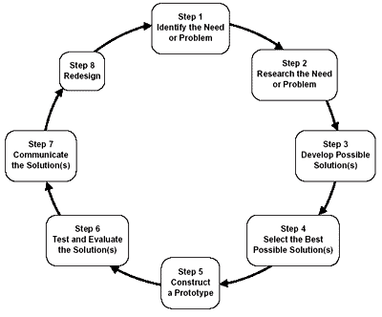
ENGINEERING DESIGN PROCESS

Slide 3
ENGINEERING DESIGN PROCESS

Slide 4
ENGINEERING DESIGN PROCESS
Let’s imagine that you have purchased a new puppy and need to build a dog house for your pet. What are the steps of the design process that you would
need to follow in order to complete your project?

Slide 5
ENGINEERING DESIGN PROCESS
What factors might you consider in your design?

Slide 6
DESIGNING A PROTOTYPE
A prototype is a model of your proposed design

Slide 7
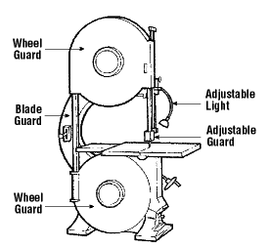
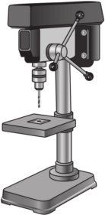
CONSTRUCTING A PROTOTYPE
What tools and materials would you need to complete your prototype?

Slide 8
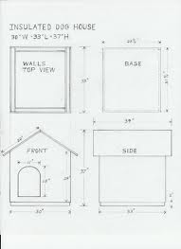
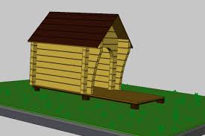
DESIGNING A PROTOTYPE
Orthographic Sketch
A prototype is a model of your proposed design
CAD
(Computer Aided Design)

Slide 9
HOW MIGHT YOU IMPROVE YOUR DESIGN?

