Slide 1
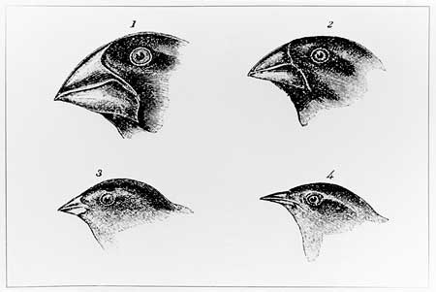
STUDY ISLAND MCAS REVIEW
LIFE SCIENCE
Assignment #3
Evolution &
Environment

Slide 2
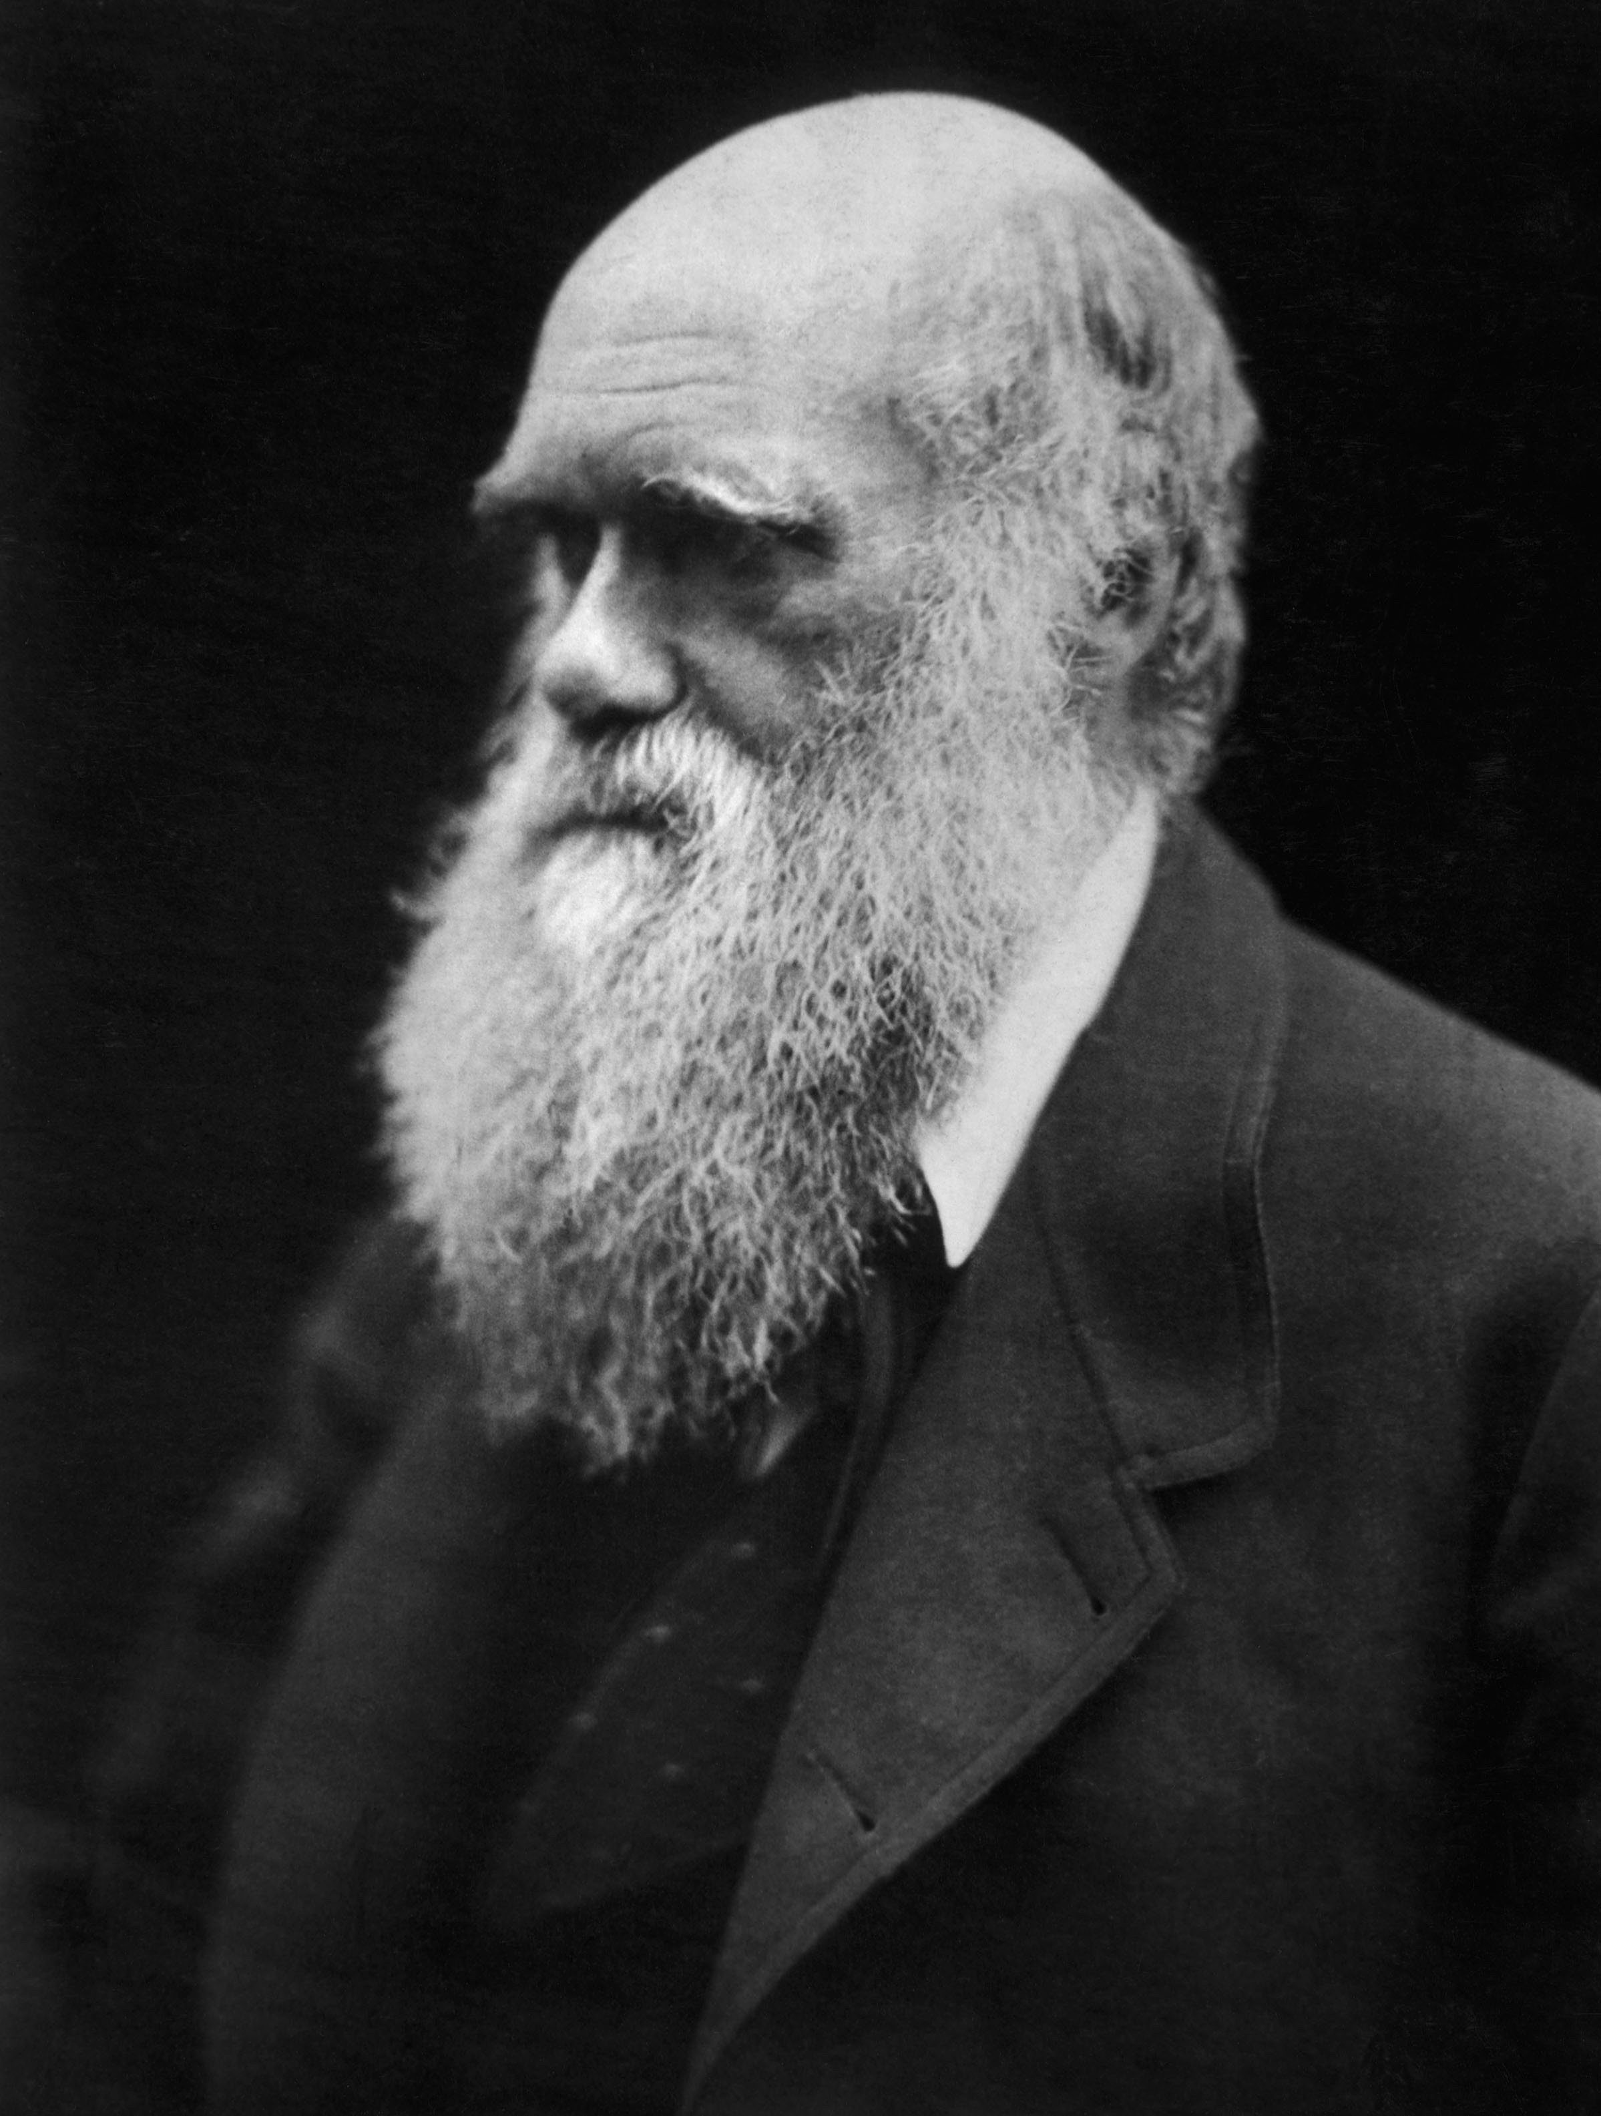
Evidence for Darwin’s
Theory of Evolution by Natural Selection
During his round-the-world voyage on the HMS Beagle, Darwin collected evidence to support the theory of evolution, that idea that species change over time and evolved from a common ancestor

Slide 3
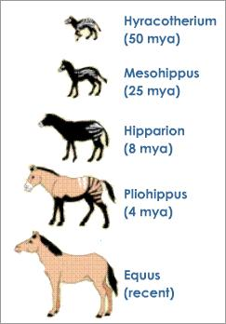
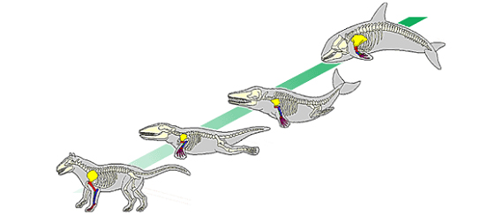
Evidence for Evolution
Species Changing Over Time
How do fossils provide evidence that species change over time?
Whale Evolution
Horse Evolution
Hominid Evolution

Slide 4
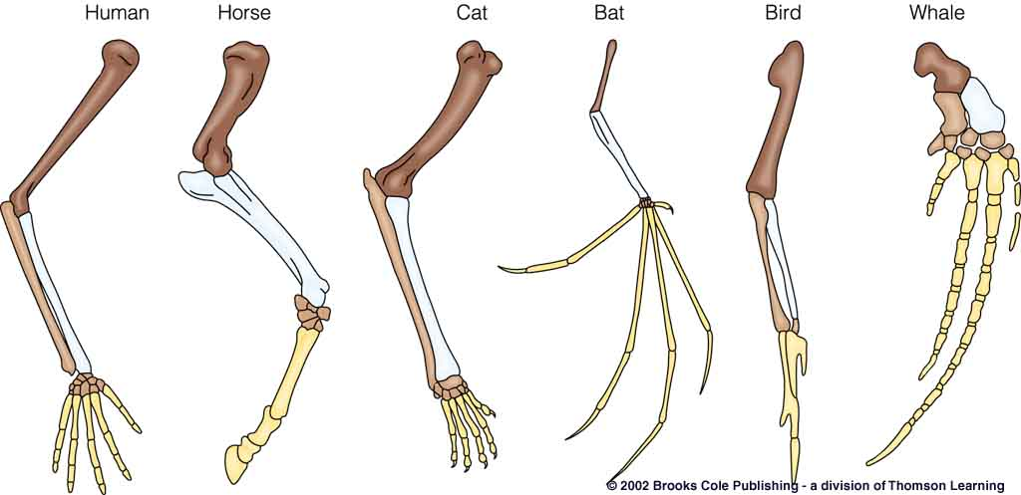
Evidence for Evolution
Species Changing Over Time
How do homologous (similar) structures provide evidence
that the following animals might share a common ancestor?

Slide 5
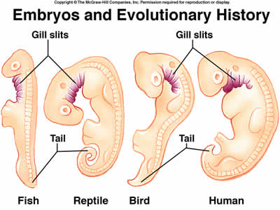
Evidence for Evolution
Species Changing Over Time
How do embryos provide evidence
that the following animals might share a common ancestor?

Slide 6
Evidence for Darwin’s
Theory of Evolution by Natural Selection
Darwin proposed that evolution occurred by natural selection:
-There is variation within populations.
- The “fittest” organisms, best adapted to an environment, will survive and reproduce.

Slide 7
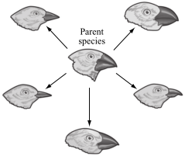
Theory of Evolution by Natural Selection
Which of the following best explains why the beak shape of each species
of bird developed differently?
A.Each beak shape helps the birds to produce different songs.
B.Each beak shape is an adaptation to a specific source of food.
C.Each beak shape is designed to construct a different type of nest.
D.Each beak shape helps protect the birds from a different predator.

Slide 8
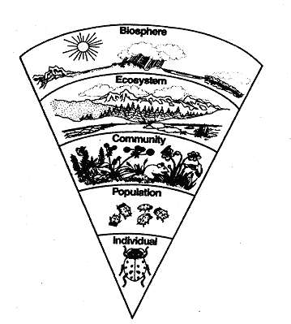
Organization of Ecological Systems
Biosphere: All of the ecosystems on Earth
Ecosystem: All of the living (biotic) and non-living
(abiotic) components of an ecological region
Community: All of the populations of different species that live in an ecosystem
Population: A group of individuals of the same species
that live in an ecosystem

Slide 9
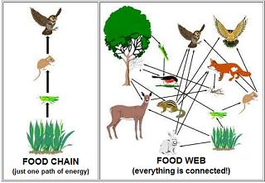
Food Chains/Webs
CAN YOU: Identify the source of energy in the food web? Identify the producers,
primary consumers, secondary consumers, tertiary consumers?

Slide 10
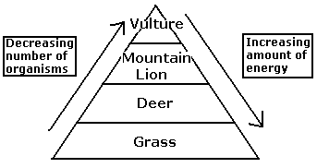
Energy Pyramids
The amount of energy available _______in the higher levels of the ecosystem because energy is used by the organisms to perform their bodily functions or is given off as heat. So, animals at the top of the pyramid have _______ energy available to them than animals at the bottom.

Slide 11
Ecosystem Energy Pyramids
The amount of energy available decreases in the higher levels of the ecosystem because energy is used by the organisms to perform their bodily functions or is given off as heat. So, animals at the top of the pyramid have less energy available to them than animals at the bottom.

Slide 12
This lesson will help you to review material
that you learned in Grade 7 Life Science and
prepare you for this week’s Study Island lesson.
Your Grade 7 teachers send best wishes
and know you will be successful on
Grade 8 Science MCAS.
YOU CAN DO IT!!

